Slide 1
Scarce Data
Problems & Solutions
Problems | Solutions
Entry errors, missing values, outliers, etc. | Data Cleaning
Not enough characteristics | Data Enrichment
Not enough “bad” - data | WOE Transformation Method
 | Characteristics Re – Weighting
 | Bayesian Approach

Slide 2
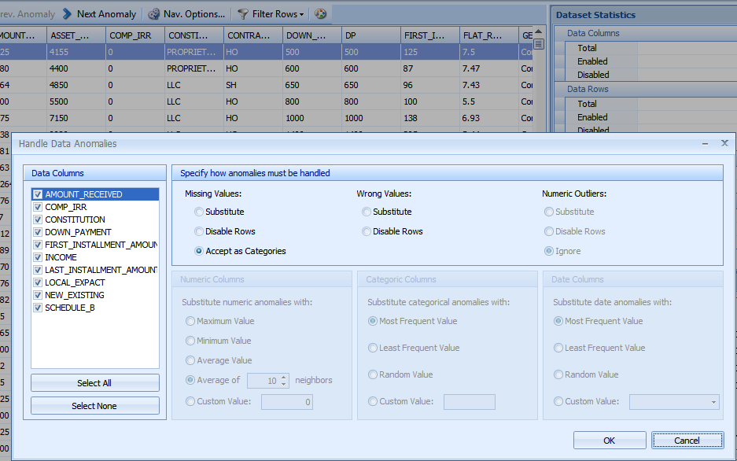
Data Cleaning
Source Data
Automatically find:
Outliers
Mussing values
Empty values
Anomalies detection and transformation functionality in Scorto Credit Decision
Delete/Replace by:
Frequent value
Max, Min, AVG, other values
Clean Data

Slide 3
Data Enrichment
Source Data
Extract additional information
Work (Employer)
Location
Industry Branch etc.
Type of business
1) Special tool for data enrichment – Scorto Refiner;
2) Transformation functionality in Scorto Credit Decision
Enriched Data

Slide 4
WOE Transformation Method
Characteristic | Category | Predictive Strength (WOE)
Sex | M | -1.4
 | F | 0.23
Salary | < 3000 | -4.2
 | 3000 - 5000 | 70.19
 | > 5000 | 164.9
Predictive Strength
Standard Approach
STANDARD APPROACH DOES NOT WORK ON LOW-DEFAULT PORTFOLIOS
WOE TRANSFORMATION APPROACH
WOE TRANSFORMATION APPROACH SHARPLY INCREASES PRECISION ON LOW-DEFAULT PORTFOLIOS AND ADDS PREDICTIVE STRENGTH

Slide 5
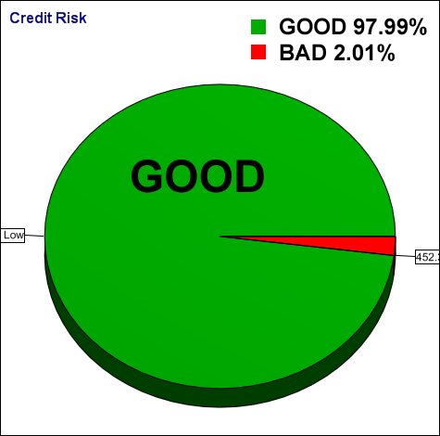
Bayesian Approach
Characteristic | Category | Bad - Rate
Sex | M | 3%
 | F | 1%
Salary | < 3000 | 25.2%
 | 3000 - 5000 | 2.4%
 | > 5000 | 0.1%
Loan Portfolio
Bad Rate = 2%
P(M|“Good”)=97%
P(M|“Bad”)=3%
P(F|“Good”)=99%
P(F|“Bad”)=1%
P(Salary<3000|“Good”)=74.8%
P(Salary<3000|“Bad”)=25.2%
P(3000-5000|“Good”)=97.6%
P(3000-5000|“Bad”)=2.4%
P(>5000|“Good”)=99.9%
P(>5000|“Bad”)=0.1%
P(“Good”)=98%
P(“Bad”)=2%
Probability of event “x”:
P(x)=P(x|”Good”)P(“Good”)+P(x|”Bad”)P(“Bad”)
P(Salary<3000)=74.8%*98%+25.2%*2%=73.8%
Probability of event “x will be Good”
Probability of event “x will be Bad”

Slide 6
Addressing “Not enough data” problem
Source Data
Data Enrichment
Enriched Data
Not enough accounts and not many Characteristics
Not enough Bad-data
Not enough accounts
Characteristics Re-weighting
WOE Transformation
Data with necessary “Good” and “Bad” borrowers number
Data will WOE instead of category’s
Regression Analysis
Regression Analysis
Bayesian Approach
Scorecard
Scorecard
Probabilities of events calculation

Slide 7
Scorecard Development Methodology
Preliminaries
and
Planning
Business Goals
Project Risks
Project Team
Data Preview and
Project Parameters
Identifications
Data Gathering
Data Cleaning
“Good” and “Bad” Definition
Data Quality
and
Quality Analysis
Enough Accounts
Enough “Bad”
Enough Characteristics
All enough
Not enough “Bad” Data
Not enough Accounts
Not enough Accounts
And Characteristics
Characteristics
Re-weighting
WOE:
Transformation
Bayesian
Approach
Logistic Regression
Approach
(DT or NN for special …)
Force
Forward Stepwise
Backward Stepwise
Scorecard
Accuracy & Adequacy Verification
ROC & Gini Risks
“Good”–“Bad”
Distribution
Choose Best Scorecard
Gini, K-S
Misclassification

Slide 8
Scorecard Development Methodology (continued)
Scorecard Scaling
Risk Parameters Analysis
PD Estimation, Score Risk Pools (scorebands)
Definition
Business Parameters Analysis
Approval Rate Definition, Revenue/Profit Impact Analysis, Cut-Off Point
Pre – Implementation Validation
Implementation
Scorecard Monitoring Cycle

Slide 9
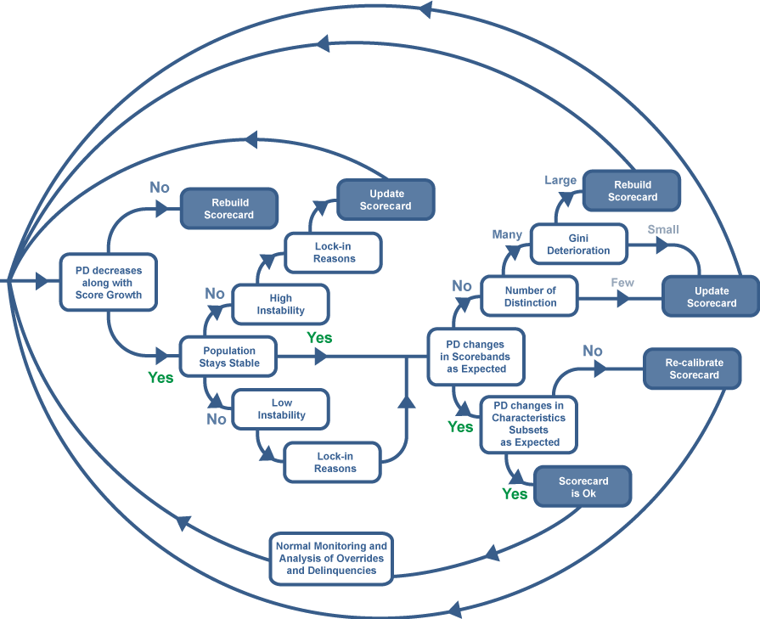
Scorecard monitoring cycle

