Slide 1
Standard platform release Version 7.10

Slide 2
Main features
Accounting functionality
Xero integration
QB integration
Escrow functionality
Improved Excel reports
2-Factor Authentication
Calc. Fee library
Calc. Manual fee
Calc. Rule 78
Calc. New schedule settings

Slide 3
Full list of features
Accounting functionality
Get your accounting reports generated in TurnKey Lender
Ready-to-go integrations with Xero and QuickBooks
Fee library
New Credit product capabilities
Manual fee
Rule 78
New schedule settings
2-Factor Authentication can be easily managed by Customers and Back-Office users.
Easier to understand system decisions on the Risk Score
Improved Excel reports
More bank account verification settings
Escrow functionality
Escrow payment inside and beyond the Loan schedule
Escrow balance management
Escrow analysis

Slide 4
Accounting
Tools → Accounting
A simple and coding-free way to set up the export of financial data that ideally matches customer’s existing accounting procedures
We do not make up new accounting reports, but we allow users to take the reports that exist in the company, set them up and automatically collect and manage them in TurnKey Lender.
Addon - Enabled in the Config

Slide 5
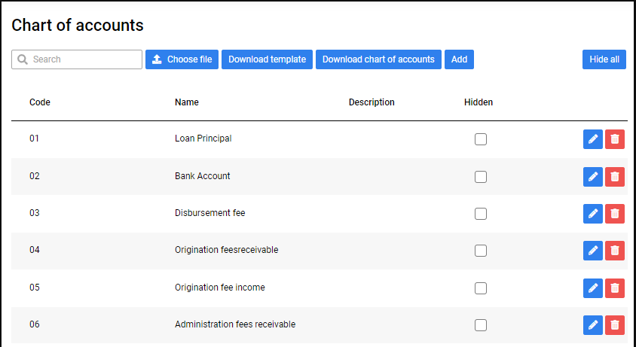
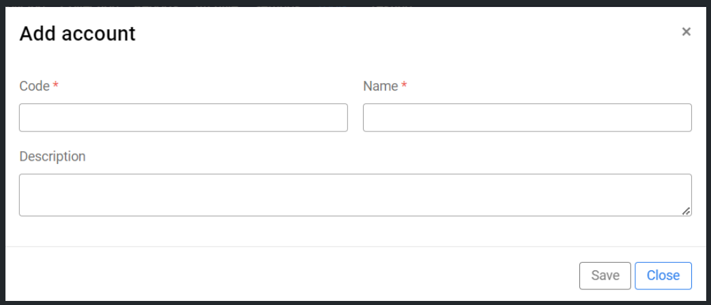
Accounting
Tools → Accounting → Chart of accounts – Add as a file
Define what accounts to use
Usually the client’s accounting office already has the chart of accounts, and the task is to recreate it in TurnKey Lender or synchonize.
Addon - Enabled in the Config

Slide 6
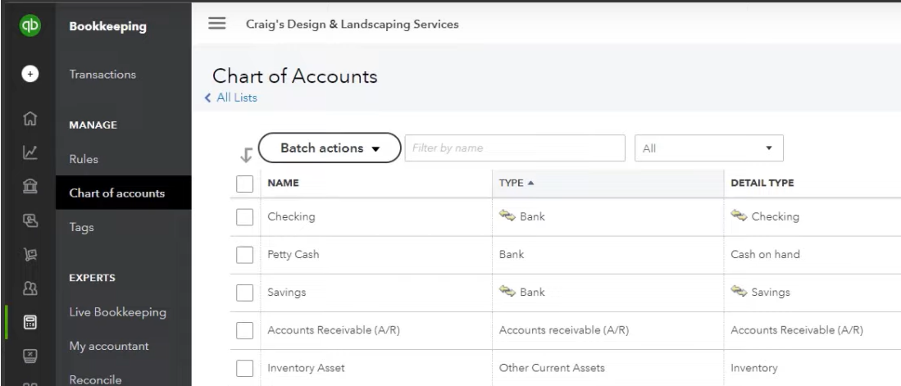
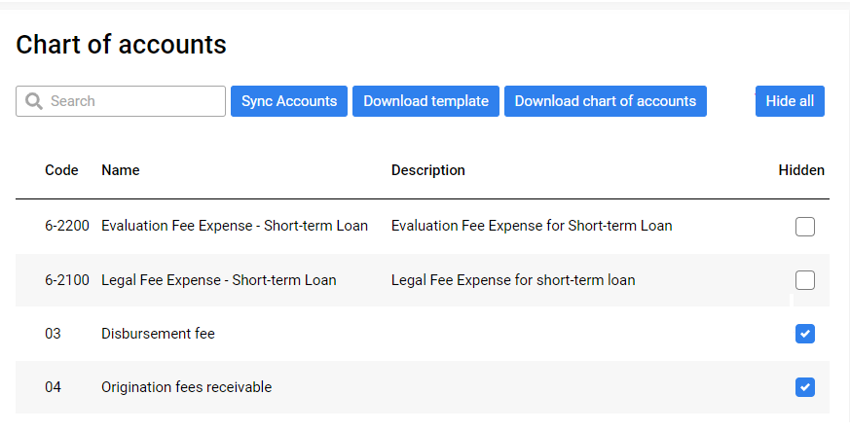
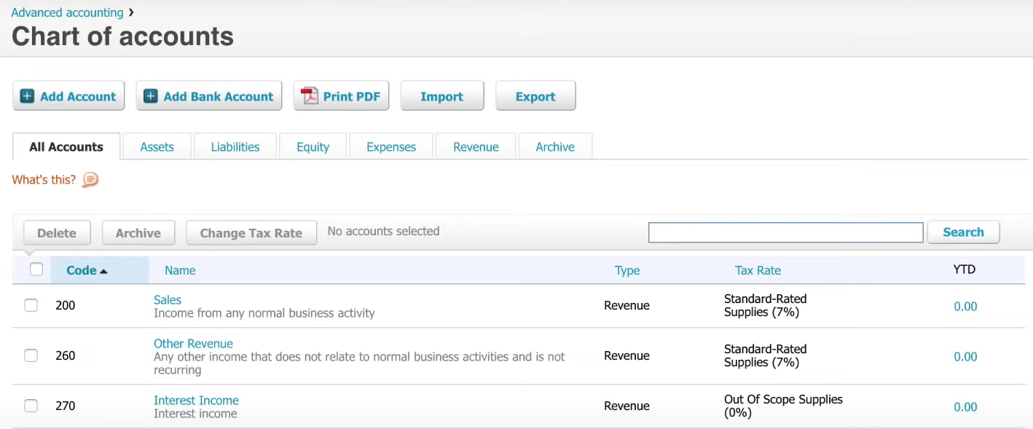
Accounting
Tools → Accounting → Chart of accounts - Sync
Synchronize the chart of accounts : Already have integrations with Xero and QuickBooks

Slide 7
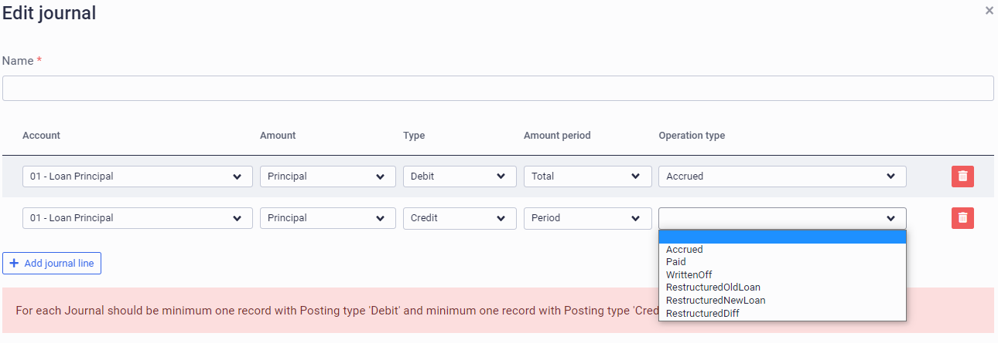
Accounting
Tools → Accounting → Settings
Define what data to collect from the accounts and arrange it in the Journals
Usually the client’s accounting office already has the journals that they commonly use. The task is to recreate it in TurnKey Lender.
Addon - Enabled in the Config

Slide 8
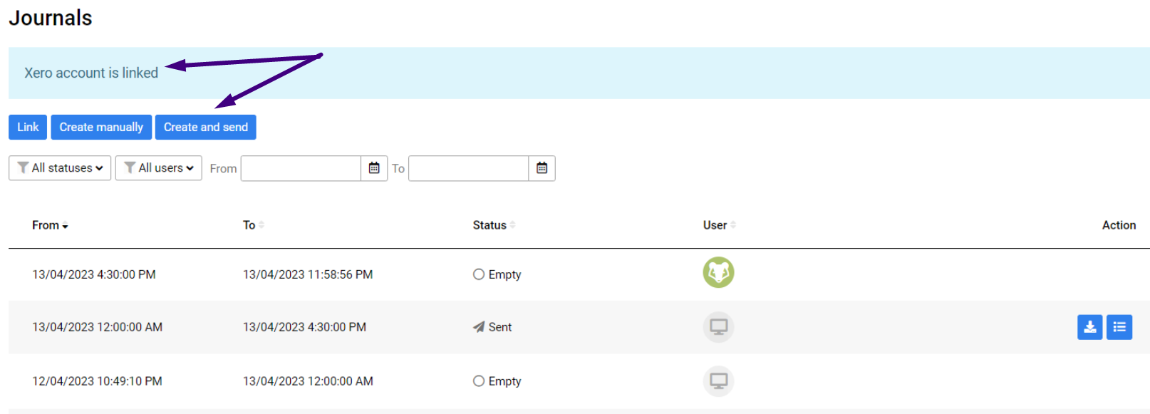
Accounting
Tools → Accounting → Chart of accounts – Journals – Create and send
If the integration has been enabled, send them to the accounting service provider.
Already have integrations with Xero and QuickBooks
Addon - Enabled in the Config

Slide 9
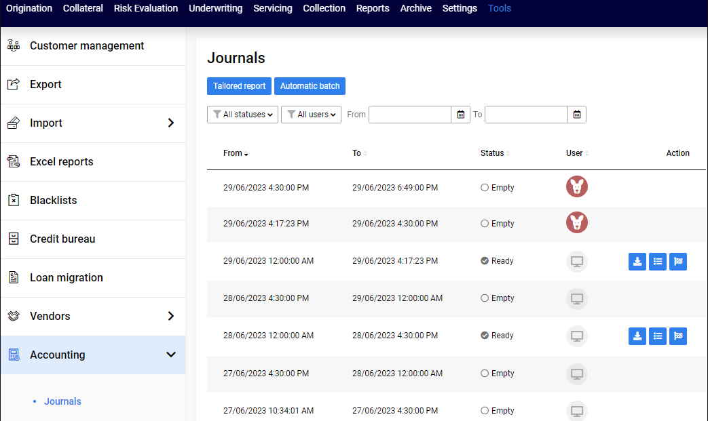
Accounting
Tools → Accounting → Chart of accounts – Journals
Collect data in the journal batches
Scheduled automatic collection
Possible manual collection at any time
Download data as .xlsx files
Enabled in the Config

Slide 10
New Credit Product Capabilities
New fee template Manual Fee
Rule 78 Loan Type
New schedule settings
Annuity Due mode
Grace Period included in the Loan Term
Due dates on the last day
Enabled in the Config

Slide 11
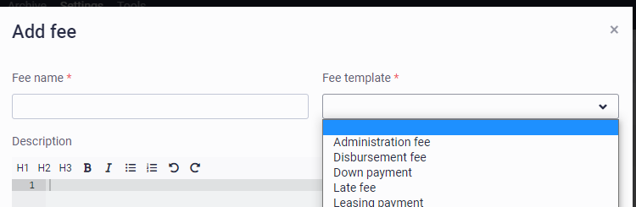
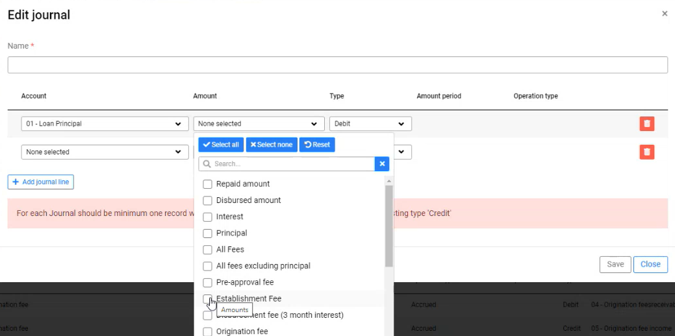
Fee Library
Settigs → Loan Settings → Fees: List of available fee names defining their templates
Still there:
Fee templates
Automatic settings for basic mode of Credit products
Any settings can be changed in the advanced mode
Changes and improvements:
Name is fixed per template:
Add all amounts of fees with the same name to an accounting journal as one item
No misspelling
Concordance through the whole company

Slide 12
New Credit Product Capabilities - Manual Fee
You’ve asked for it – here it goes!
A non-scheduled fee that can be added:
To an active loan
Manually
At any point after disbursement
Business Usage Examples:
Enforcement fee
Call charges
Parking costs
Legal fees
Additional services for leased items

Slide 13
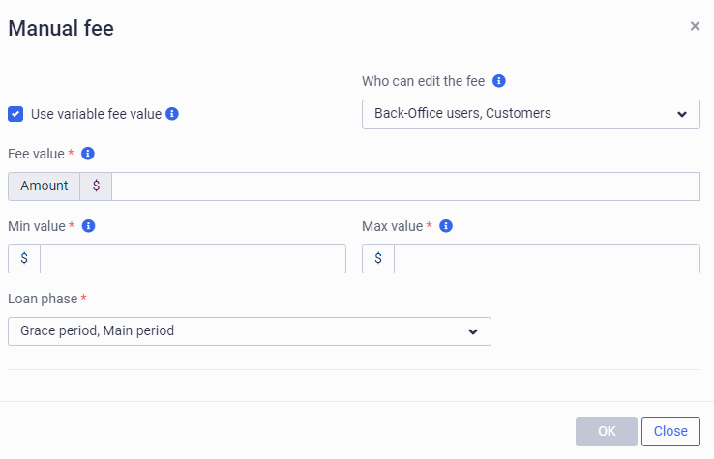
Manual Fee Settings
Adding to the product (Settings → Loan Settings → Credit Products...)
Add a Fee assigned to the Manual Fee template (Settings → Loan Settings → Fees)
Add the fee to the Credit Product
Define the fee settings

Slide 14
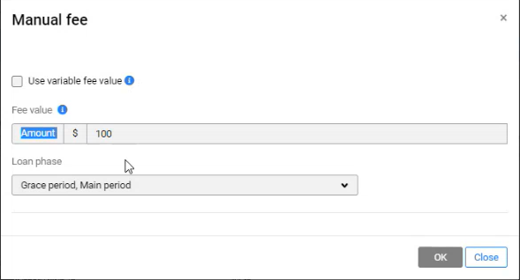
Manual Fee Usage
Apply the Fee (Servicing → Manual fees)
Apply the fee manually at any point during Grace period and/or Main period

Slide 15
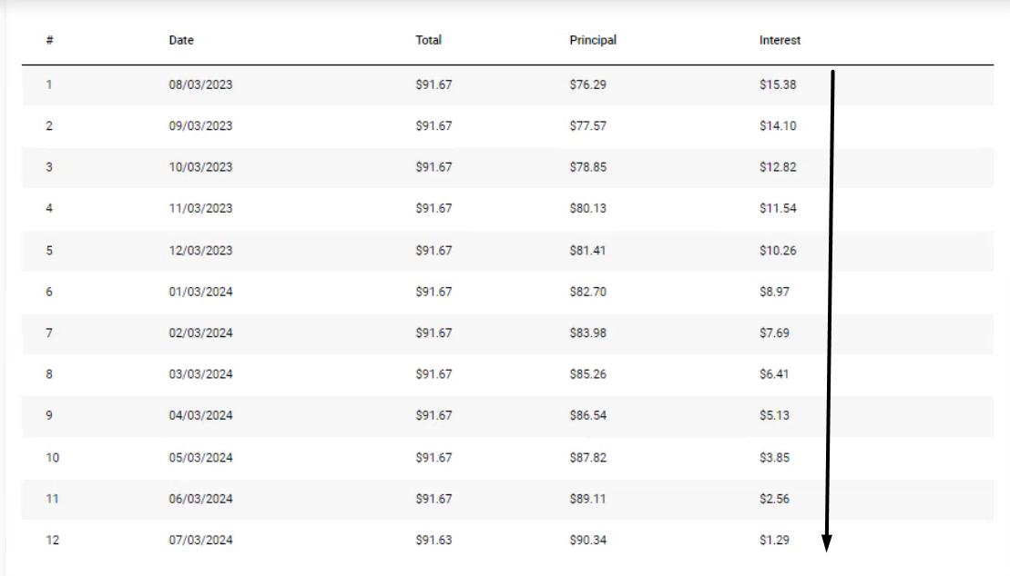
New Credit Product Capabilities – Rule 78 Loan Type
Industry-wide method of calculating and applying interest on a loan that allocates a larger portion of the interest charges to the earlier loan payments
New Loan Type:
Supports industry wide method (especially popular in APAC)
Applies larger portion of interest at first installments
More profit for the lender

Slide 16
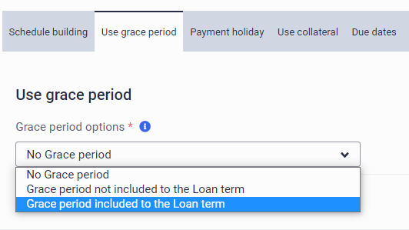
New Scheduling Capabilities – Grace Period
Include Grace period in the Loan term
Just as before:
You can add Grace period to the Loan term („not included”)
But now:
You can add Grace period not changing the Loan term

Slide 17
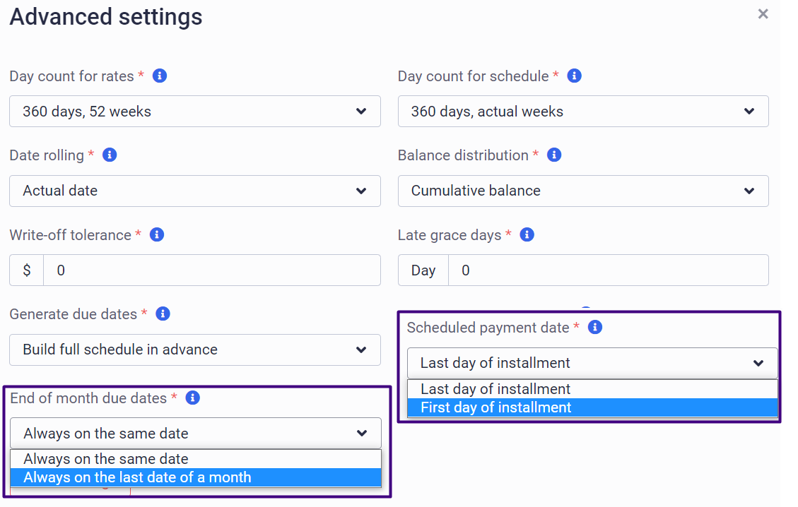
New Scheduling Capabilities – Advanced Settings
New Avanced Settings
Set the installment date to the first day of installment, in particular for Annuity Due model (used in rent payments, insurance premiums, car lease payments, etc.)
Automatically adjust the schedule to the last day of each month

Slide 18
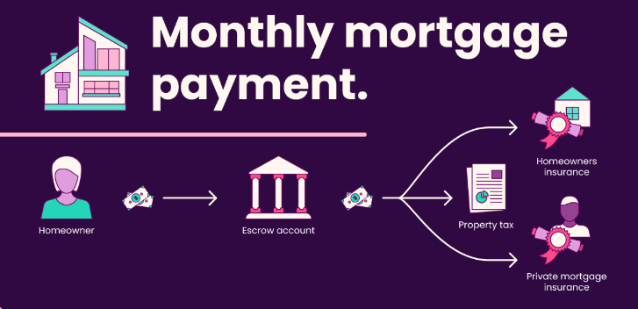
Escrow Functionality
An escrow agent receives and disburses funds for the primary transacting party under preliminary agreed conditions.
Escrow is an account separate from the mortgage account where deposit of funds occurs for payment of certain conditions that apply to the mortgage. Since a mortgage lender is not willing to take the risk that a homeowner may not pay property tax or another obligatory payment, escrow is often required under the mortgage terms.
Popular in the US
Particularly in the real estate industry
Addon - Enabled in the Config

Slide 19
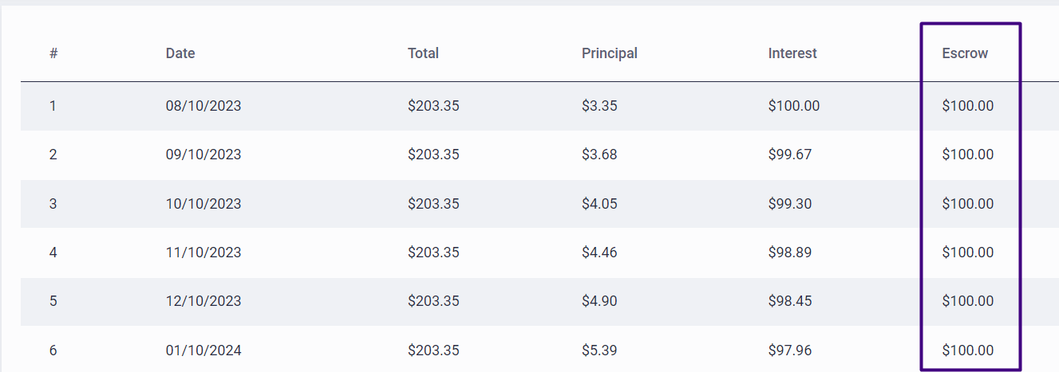
Escrow Functionality Include escrow fee in the general schedule
Lender defines the escrow fee for the first year
The escrow fee is included into installment payments
The escrow fee is collected on the escrow account
Addon - Enabled in the Config
Notes:
Escrow is an account separate from the mortgage account where deposit of funds occurs for payment of certain conditions that apply to the mortgage. Since a mortgage lender is not willing to take the risk that a homeowner may not pay property tax or another obligatory payment, escrow is often required under the mortgage terms.

Slide 20
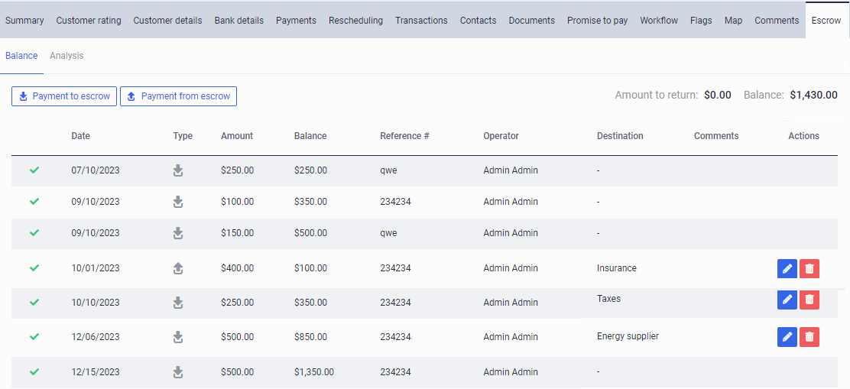
Escrow Functionality - Balance
Escrow account can be managed easily.
Replenish the balance beyond the Loan schedule (register payments to escrow)
Make payments from the escrow account to different destinations (Payment from escrow)
See the escrow balance history
Addon - Enabled in the Config

Slide 21
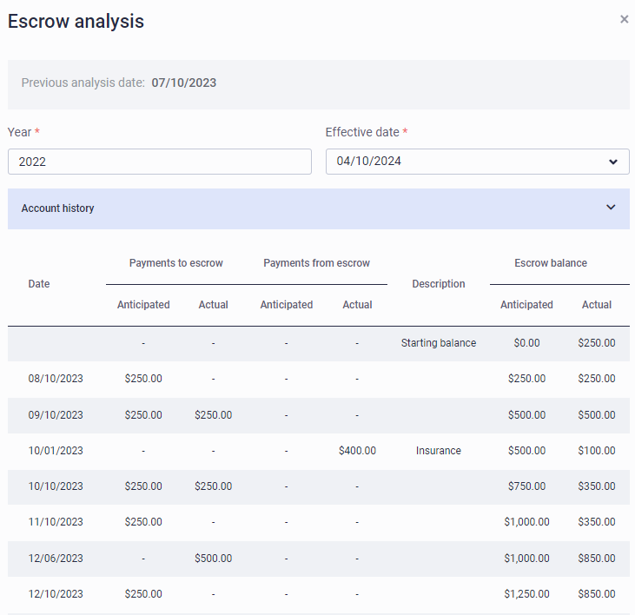
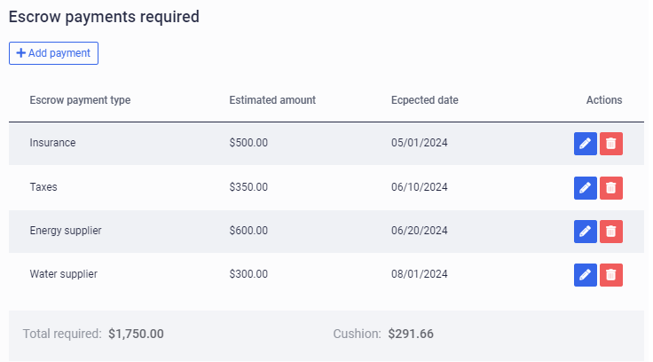
Escrow Functionality - Analysis
View the escrow balance now and historically
View the account history
Automatically return excessive funds at the end of the year
Add obligatory payments for the next year with their dates
Report can be edited until submitted. The payment will be recalculated.

Slide 22
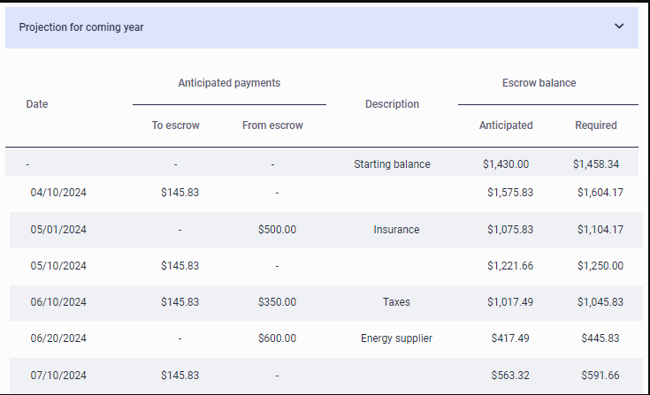
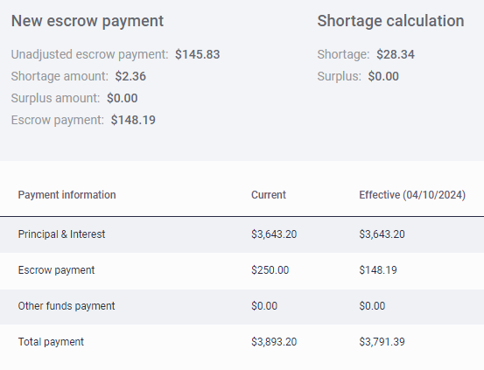
Escrow Functionality – New Schedule
Payment for the next year of the Loan schedule will be generated.
Ensures funds on the escrow balance to cover all obligatory payments.
Gets the final balance for the year as close as possible to zero.
Analysis report can be uploaded and sent.
Automatically returns excessive funds at the end of the year (Settings → Application process → Escrow → Min overpayment to return)

Slide 23
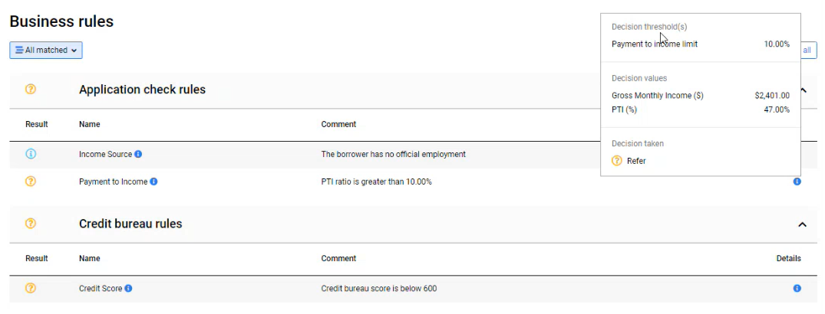
More Informative Risk Score Tab
Application check rules: See why the decision has been made
Easy-to-comprehend comments and details
Details contain information as it was at the point of the decision making

Slide 24
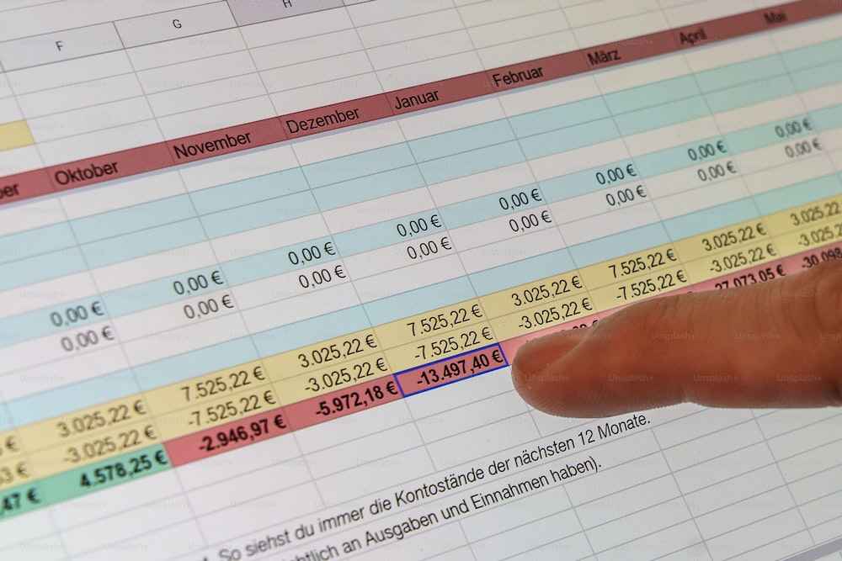
Improved Excel Reports
Tools → Excel Reports
List of Smart Markers
Upload Smart Markers to template
Depository for bigger reports
Enabled in the Config

Slide 25
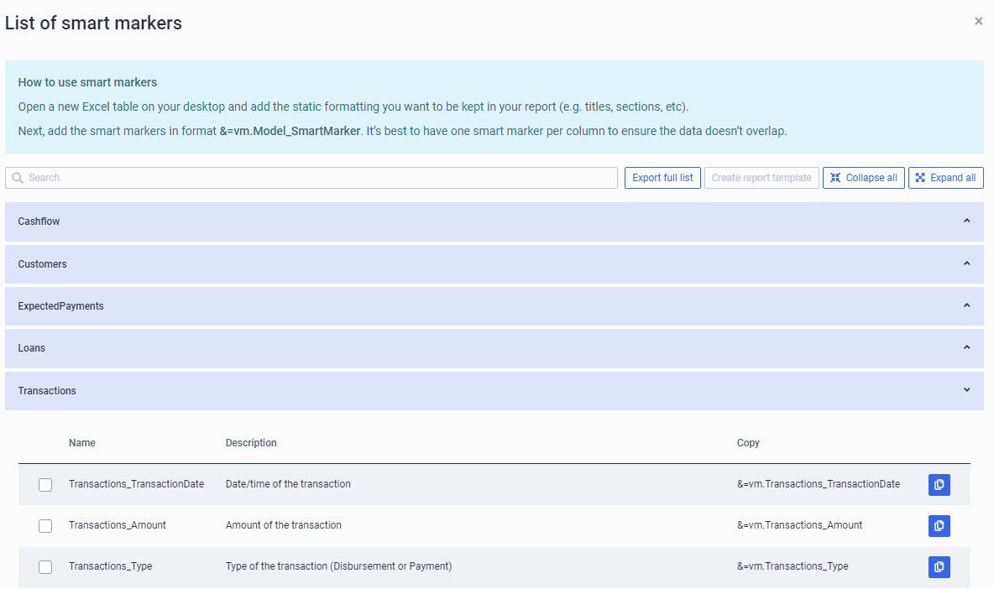
Improved Excel Reports – List of Smart Makers
Tools → Excel Reports → Report builder
See all Smart Markers
Available for this client
Divided into categories
Export full list for further usage („Export full list”)

Slide 26
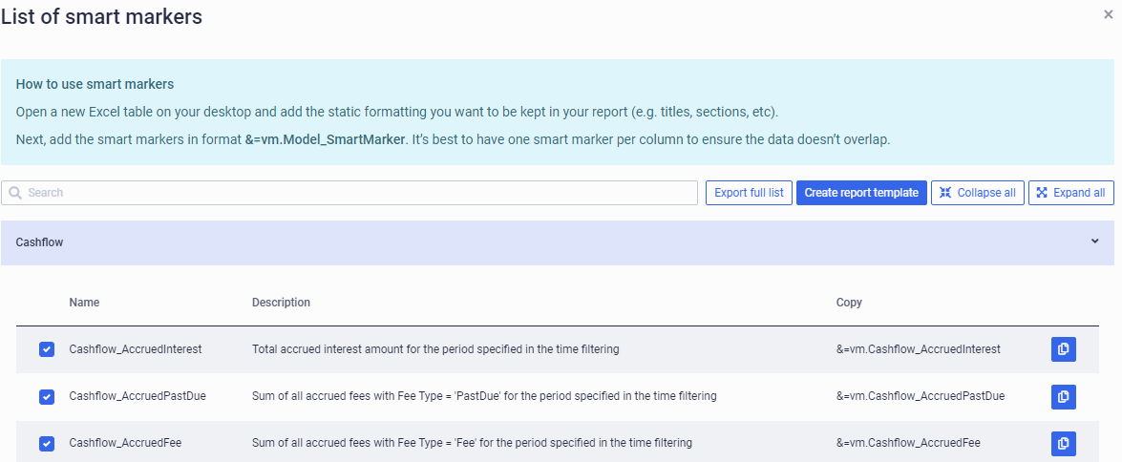
Improved Excel Reports – Upload to Template
Tools → Excel Reports → Report builder → Smart Markers
Copy Smart Markers as you could copy Merge Fields in the documents
Select Smart Markers and Create a Report template
Template still has to be formatted to make a nice report

Slide 27
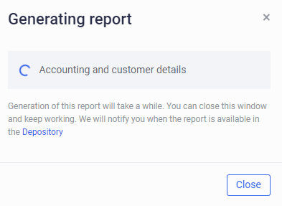
Improved Excel Reports – Depository
Tools → Excel Reports → Report depository: No more enforced idleness
If loading the report takes to long it is saved in the Depository
The user can close this window and go on working with the system
A message is generated when the report is ready
Big reports of this user are saved in the depository

Slide 28
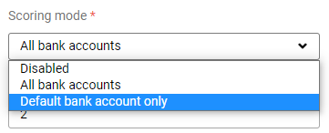
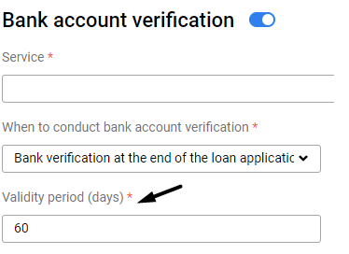
More Bank Account Verification Settings
Settings → Integrations → Bank account verification
Validity period
Scoring mode
Just as before:
When a new application is processed, the system checks if there is a Bank Verification report for the customer and does not request a new report of it exists.
But now:
If the report is older than the validity period, the system will ignore it and request a new one.
Just as before:
Can be disabled or use all bank accounts for scoring
But now:
Can use the default (main) bank account only
Smart decision with new decision rules for Experian US, Flinks, and loan applications.

Slide 29
New Decision Rules
Settings → Decision Engine → Decision Rules
More decision rules for even smarter automation of the decision-making process. The main ones:
Experian:
SSN validation
Separate delinquency checks for different periods from 30 to 180 days
Threshold for the number of overdue liabilities
Flinks:
Bank account validation
Analysis-based rules assessing the number of bancrruptcy payments, overdrafts and point of negative balance within different periods from one to six months.
Application check:
Dedicated residence time thresholds for homeowners and tenants
Current and historical thresholds on the deliquency amounts and number of past due days

Slide 30
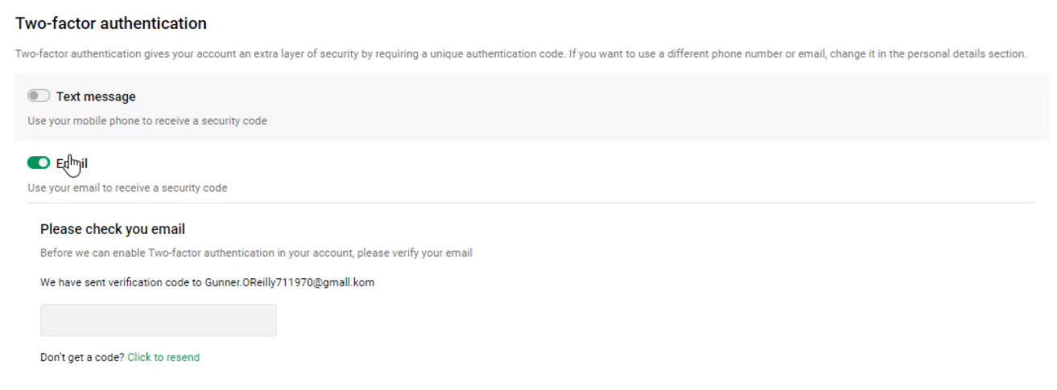
2-Factor Authorization for Customers
Can now be set up by the customers from the portal
Authentication settings can be available for any logged-in customer.
Requires integration with the SMS/E-mail service provider

Slide 31
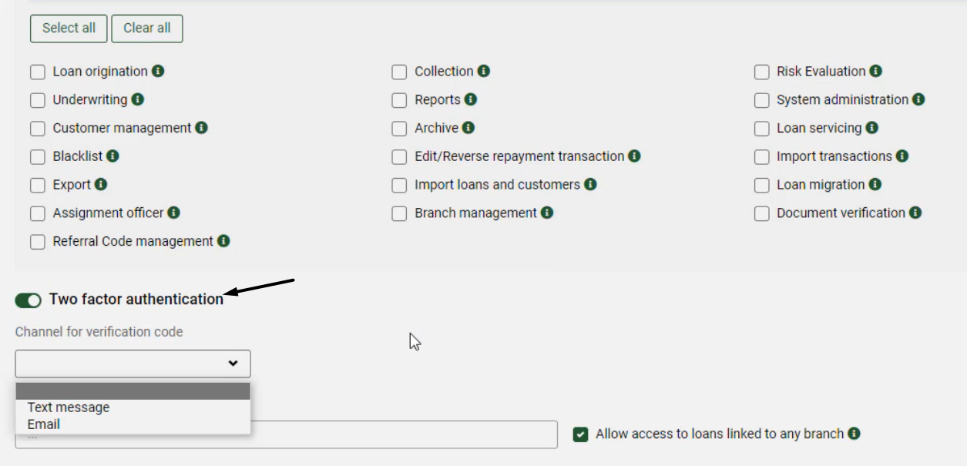
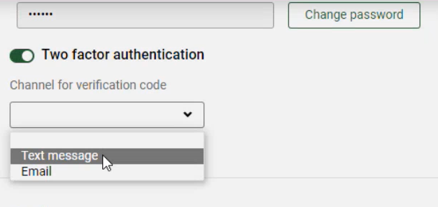
2-Factor Authorization for Back-Office Users
Can now be defined by the Admin or the Back-Office User
Authentication settings can be defined in the Settings → Users
Or defined in the User Profile
Requires integration with the SMS/E-mail service provider

Slide 32
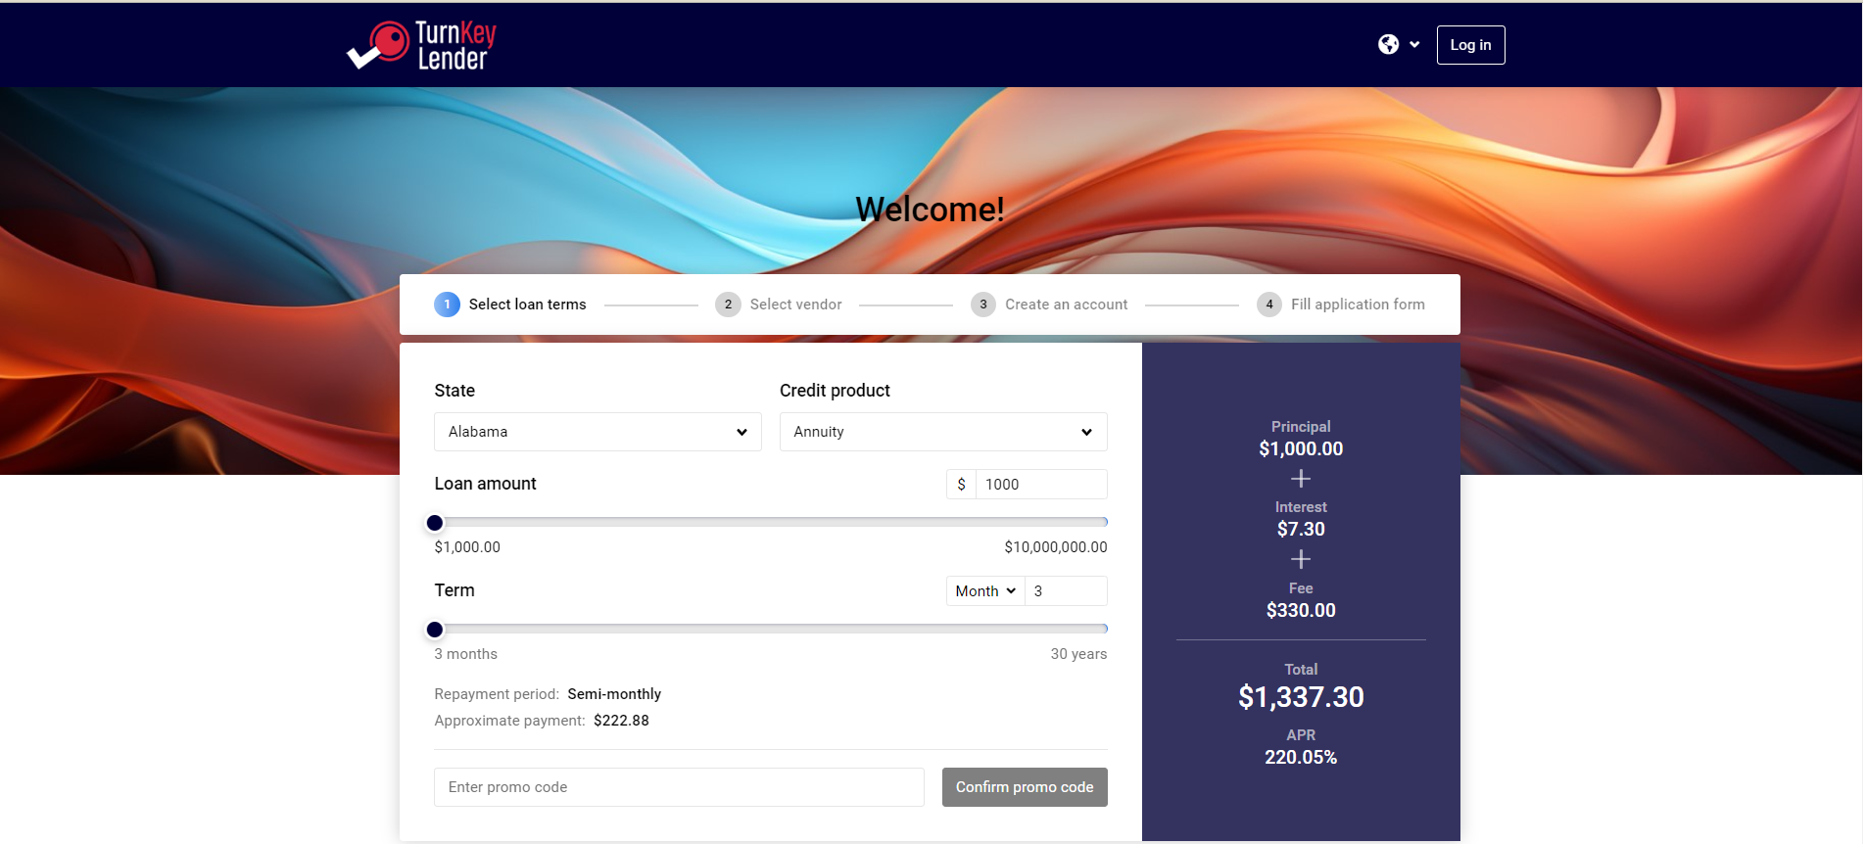
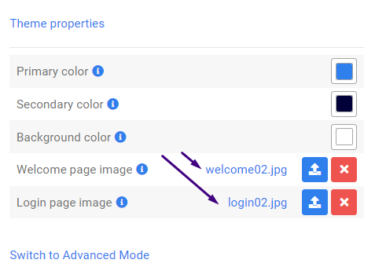
Separate Image for Login Page
Settings → Appearance → Custom page
Upload a separate image for the Login page (Appearance → Custom theme)

Slide 33
Other things to mention
Smart and optimized automatic Credit Bureau requests to avoid excessive requests and save lenders' funds.
The list of Flinks (bank statements) attributes our system interprets and uses in customer risk analysis got extended which gives you even better instant insight.
New Integrations with Quickbooks and XERO (Accounting).
New integration with Repay (Canada) allow us to better process payments in Canada
Improved integration with Zum Rails (Canada) allow us to better process payments in Canada.
Transunion (Canada) integration improvement for easier soft and hard pulls.
Experian (US) integration updated to notify the lender if obligatory reports haven’t been sent on time.

